Slide 1


Data on the web
an inconvenient truth

Slide 2
Data on the web
some inconvenient truths

Slide 3
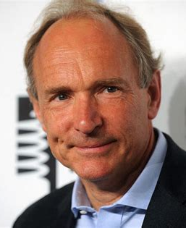
Most data on the web is not Linked Data
1
(we don’t care)
“The system is failing.”
“We have to grit our teeth and hang on to the fence and not take it for granted that the web will lead us to wonderful things.”*
Tim Berners-Lee
* https://www.theguardian.com/technology/2017/nov/15/tim-berners-lee-world-wide-web-net-neutrality

Slide 4
Most data on the web is not Linked Data
1
Relatively speaking, the LD-berg is melting

Slide 5

Most web API’s are not RESTful
2
I am getting frustrated by the number of people calling any HTTP-based interface a REST API. Today’s example is the SocialSite REST API. That is RPC. It screams RPC. There is so much coupling on display that it should be given an X rating*.
(current API’s are like SOAP webservices
- with JSON)
Roy Fielding
* http://roy.gbiv.com/untangled/2008/rest-apis-must-be-hypertext-driven

Slide 6

Context

Slide 7

Data
Context information

Slide 8
Data
Would you use it without context?
{
"@context": "https://taxoffice.com/def#",
"@type": "Person",
"income": 25000
}

Slide 9
Most data on the web is fake data
3
Fake data = data without context

Slide 10
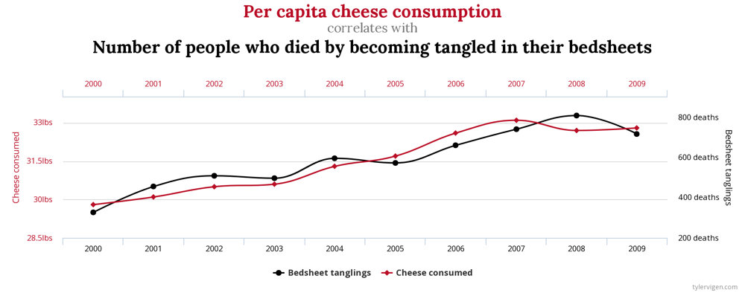
fake data
3
“Eating cheese gets you killed in bed”*
Data sources: U.S. Department of Agriculture and Centers for Disease Control & Prevention
*http://tylervigen.com/spurious-correlations

Slide 11

Take care about your data
Don’t pollute the web with fake data
Publish fair data
findable
accessible
interoperable
reusable
fair data = data with context
*https://www.nature.com/articles/sdata201618

Slide 12
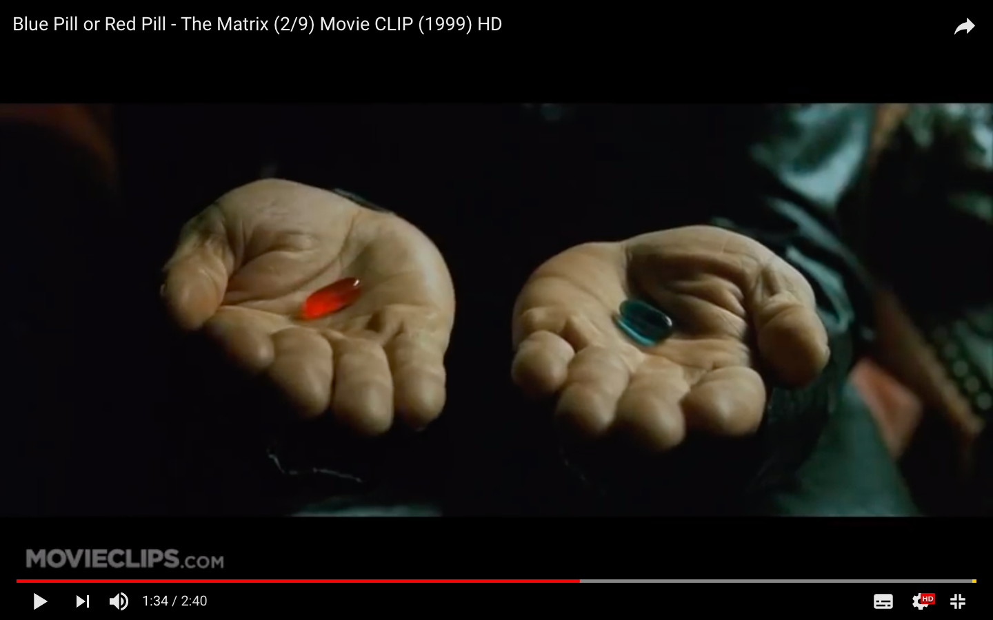

This is your last chance. After this there is no turning back.
You take the blue pill: the story ends. You wake up in your bed and believe whatever you want to believe.
You take the red pill: you stay in wonderland. And I show you how deep the rabbithole goes.
fair data
fake data
Notes:
https://www.youtube.com/watch?v=zE7PKRjrid4

Slide 13


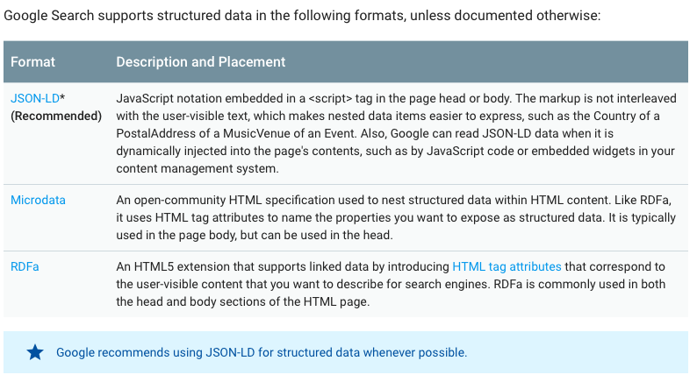

fair data
Data on the web =
Data on the web = structured data
(in some way or another)
https://developers.google.com/search/docs/guides/intro-structured-data

Slide 14
fair data
The four rules:
1. Link to context (and other things)
2. Use standards when someone looks up something
3. Use API’s and publish contextual information
4. Use IRI’s as names for things
2019
“a surprising amount of data isn't linked in 2006, because of problems with one or more of the steps.
Use URIs as names for things
Use HTTP URIs so that people can look up those names.
When someone looks up a URI, provide useful information, using the standards (RDF*, SPARQL)
Include links to other URIs. so that they can discover more things.”*
Tim Berners-Lee
* https://www.w3.org/DesignIssues/LinkedData

Slide 15
fair data
RULE 1:
Link to context (and other things)

Slide 16
fair data
Content-type:
application/ld+json
text/turtle
application/rdf+xml
…
RDF document
(JSON-LD, turtle,
XML/RDF, ...)
RDFS/OWL
vocabulary
IRI
JSON-LD
response
from API
@id
Content-type:
application/ld+json
@context
JSON-LD
Context
document
JSON
response
from API
http Link header
Content-type:
application/json

Slide 17
fair data
JSON
response
from API
HTTP/1.1 200 OK
...
Content-Type: application/json
{
"@type": "Pand",
"identificatiecode": "0505100000065618"
}

Slide 18
fair data
JSON-LD
response
from API
JSON-LD
Context
document
@context
HTTP/1.1 200 OK
...
Content-Type: application/ld+json
{
"@context": "http://bag.basisregistraties.overheid.nl/def/bag#",
"@type": "Pand",
"identificatiecode": "0505100000065618"
}

Slide 19
fair data
JSON
response
from API
HTTP/1.1 200 OK
...
Content-Type: application/json
{
"@type": "Pand",
"identificatiecode": "0505100000065618"
}

Slide 20
fair data
JSON
response
from API
JSON-LD
Context
document
http Link header
HTTP/1.1 200 OK
...
Content-Type: application/ld+json
Link: <http://bag.basisregistraties.overheid.nl/def/bag.jsonld>;
rel="http://www.w3.org/ns/json-ld#context"; type="application/ld+json"
{
"@type": "Pand",
"identificatiecode": "0505100000065618"
}

Slide 21
fair data
RULE 2:
Use standards when someone
looks up something

Slide 22
fair data
JSON-LD
Context
document
RDFS/OWL
vocabulary
@id
@context
dct:subject
SKOS
concept
definition
JSON-LD
document
from API
sh:targetClass
SHACL
Shapes graph
dcat:endpointURL
dct:conformsTo
DCAT
dataset & API
description
VOID
interlinked
dataset
description
void:target

Slide 23
fair data
skos
concept:Pand a skos:Concept;
skos:definition “…”
dct:source <http://…>
.
owl
class:Pand a owl:Class;
rdfs:subClassOf geo:Feature;
dct:subject concept:Pand
.
rdfs
dc
property:pandrelatering a owl:ObjectProperty.
shape:Pand a sh:NodeShape;
sh:targetClass class:Pand;
.
shacl
shape:pandrelatering a sh:PropertyShape;
sh:path property:pandrelatering;
sh:class class:Pand;
.
dcat
dataset:Bag a dcat:Dataset;
dcat:contactPoint organisation:Kadaster;
void:subset dataset:Panden;
.
dataset:Pandadressen a void:Linkset;
void:target dataset:Panden;
void:target dataset:AdresseerbareObjecten;
void:linkPredicate property:pandrelatering
.
void

Slide 24
fair data
RULE 3:
Use API’s and
publish contextual information

Slide 25
fair data
API’s because:
People know what to expect
Developer friendly JSON
Entity representation is easy
Services are possible to
Publish context because:
No need for external knowledge
Anybody can use anything from anyone

Slide 26
Why do we need API’s?
Why is Linked Data not developers friendly??

Slide 27

fair data
http://example.org/id/car/somecar
https://example.org/doc/car/somecar
@prefix schema: <http://schema.org/>.
@prefix rdfs: <http://www.w3.org/2000/01/rdf-schema#>.
@prefix foaf: <http://xmlns.com/foaf/0.1/>.
<http://example.org/id/car/somecar> a schema:Car;
rdfs:label "some car";
schema:color "red";
foaf:primaryTopicOf <https://example.org/doc/car/somecar>
.

Slide 28
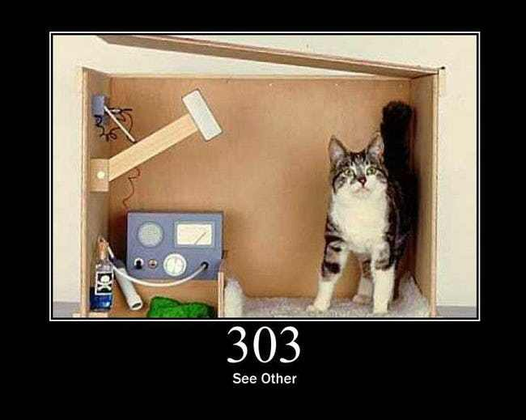
Schrödinger’s cat
fair data
{
“name”: “John Doe”,
“@type”: “Person”,
“likes”: ”https://example.org/doc/car/somecar”
}
What does John like?
A [] some car;
B [] a webpage about a car.

Slide 29
Schrödinger’s cat
fair data
{
“name”: “John Doe”,
“@type”: “Person”,
“owns”: ”https://example.org/doc/car/somecar”
}
What does John own?
A [] some car;
B [] a webpage about a car.

Slide 30
Did I just use quantum mechanics
to explain Linked Data??

Slide 31
Why do we need Linked Data?
Why can’t we simple use the API??

Slide 32
fair data
API’s are always information resources
Most identifiers in data are about real-life things
To find an API, you need context
To use an API, you need context
To find context, identify this context with a URL!
Using Linked Data for context is easy!
(and it doesn’t require quantum mechanics)

Slide 33
fair data
RULE 4:
Use IRI’s as names for things

Slide 34
fair data
{
"@context": "http://bag.basisregistraties.overheid.nl/def/bag#",
"@type": "Person",
"name": "John Doe",
"residence": "2351"
}
Where does John live?
A [] in a number;
B [] somewhere identified by ”2351”;
C [] don’t know, need more context

Slide 35
fair data
{
"@context": "http://bag.basisregistraties.overheid.nl/def/bag#",
"@type": "Person",
"name": "John Doe",
"residence": "http://bag.basisregistraties.overheid.nl/bag/id/woonplaats/2351"
}
Where does John live?
A [] in a woonplaats;
B [] somewhere identified by ”http…”;
C [] in Dordrecht;
D [] all of the above.

Slide 36

fair data
Use Links:
http://bag.basisregistraties.overheid.nl/bag/id/woonplaats/2351
“Links are simply better
Web APIs that pass out database keys rather than links are harder to learn and harder to use for clients. They also couple clients and servers more tightly together by requiring more shared knowledge and so they require more documentation to be written and read. Their only advantage is that because they are so common, programmers have become familiar with them and know how to produce them and consume them.”*
* https://cloud.google.com/blog/products/application-development/api-design-why-you-should-use-links-not-keys-to-represent-relationships-in-apis
Martin Nally,

Slide 37

To take home:
Use API’s to exchange data on the web;
Use Linked Data standards to describe context;
Link your API’s to this context;
Use IRI’s
Follow the best practices!
https://www.w3.org/TR/dwbp
https://json-ld.org/spec/latest/json-ld-api-best-practices/

Slide 38



about me
Ir. Marco Brattinga Senior principal expert marco.brattinga@ordina.nl http://nl.linkedin.com/in/marcobrattinga
about context (currently only dc:language “nl”)
BP4mc²
http://bp4mc2.org/profiles

Slide 39

fake data
API’s that work within a specific context;
No need to talk about context;
Data remains in its silo;
Understanding data remains in the hands of big corporations;
Lots of work for the IT department.

